Slide 1

Calendars! Calendars! Calendars!
Investigating M365 Calendars!
Tamara.Bredemus@live.com

Slide 2
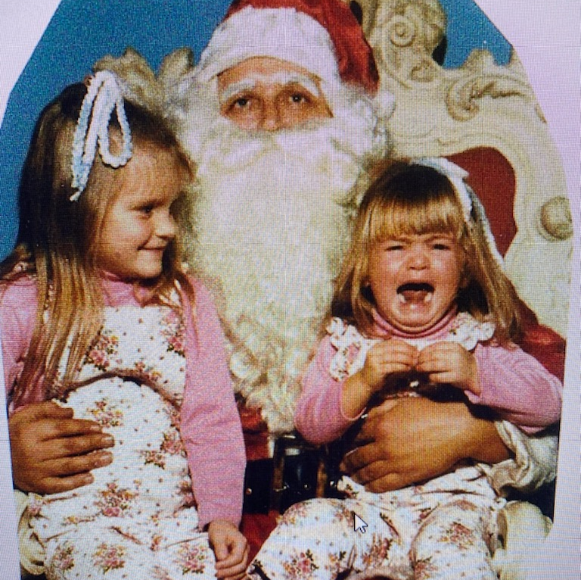
Tamara Bredemus
Tamara.Bredemus@live.com
Principal Learning Strategist
& Adoption Specialist
with Planet Technologies
SharePoint since 2008
HeyTamara.com
I am on the left

Slide 3
Agenda
SharePoint Online
Teams
Outlook/Exchange
Bookings
Planner
The Matrix

Slide 4
SharePoint
List
Classic Calendar
Events Web Part
Group Calendar Web Part

Slide 5
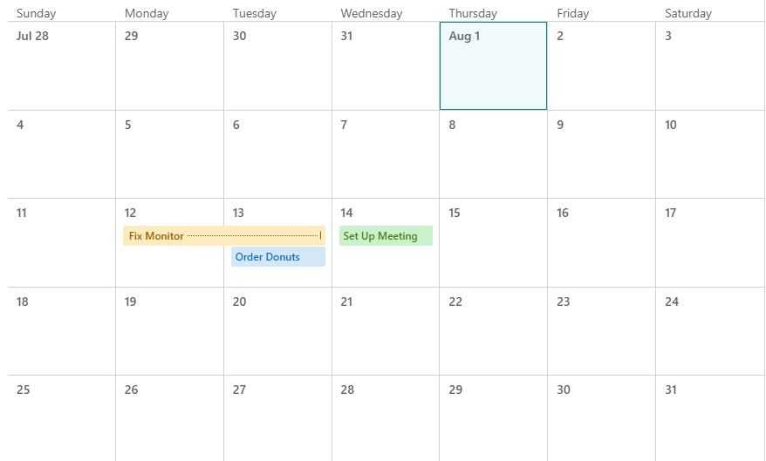
List with Calendar View
Notes:
Lists provide a flexible way to organize, manage, and share information within a team or organization.
Lists in SharePoint can be customized to create a Calendar view
Features:
Presents list items as a calendar grid
Visually appealing way to interact with date-based data
Customizable display settings and filtering

Slide 6
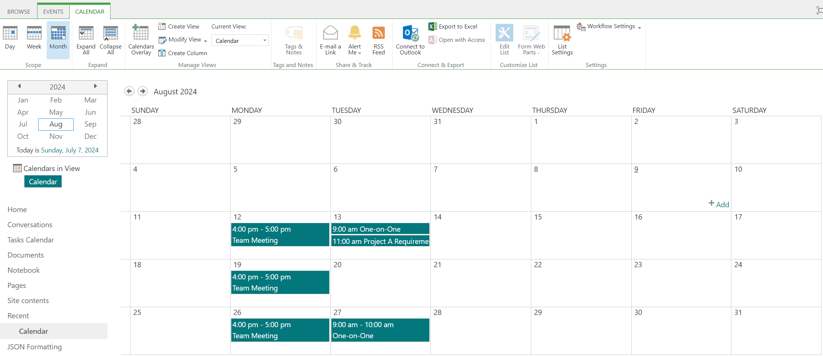
Classic Calendar
Notes:
Available to add as an “app”
Has classic ribbon menu
Can connect/sync to Outlook desktop; sync has been known to be inconsistent
Features:
Completely stand alone
Not connected to Outlook
Option to add to calendar is a static invite and will not update for the user

Slide 7
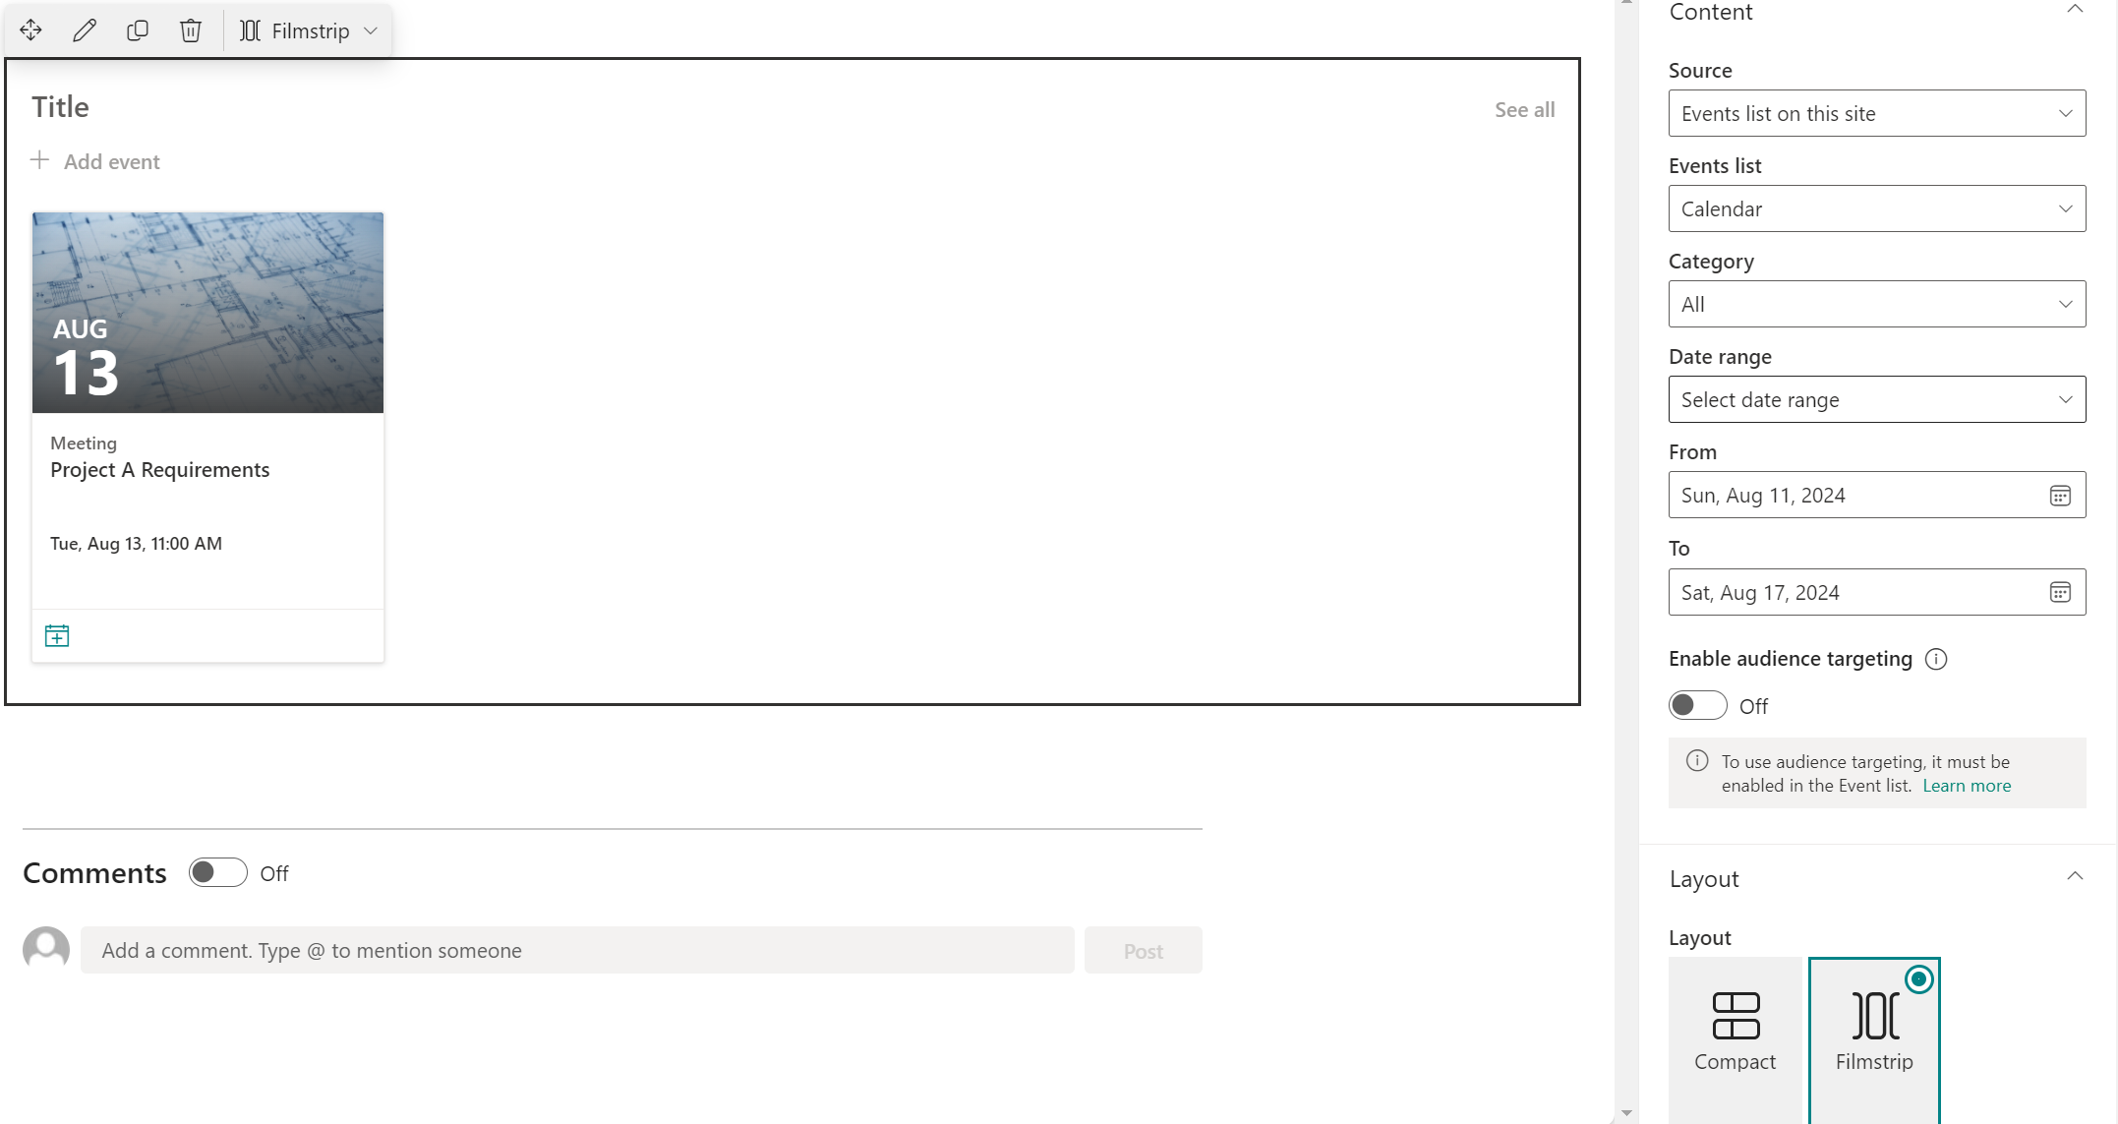
Events Web Part
Notes:
A visual SPO web part that is tied to an Event List
Features:
Gives option to “Add to Calendar”
Still stand alone

Slide 8
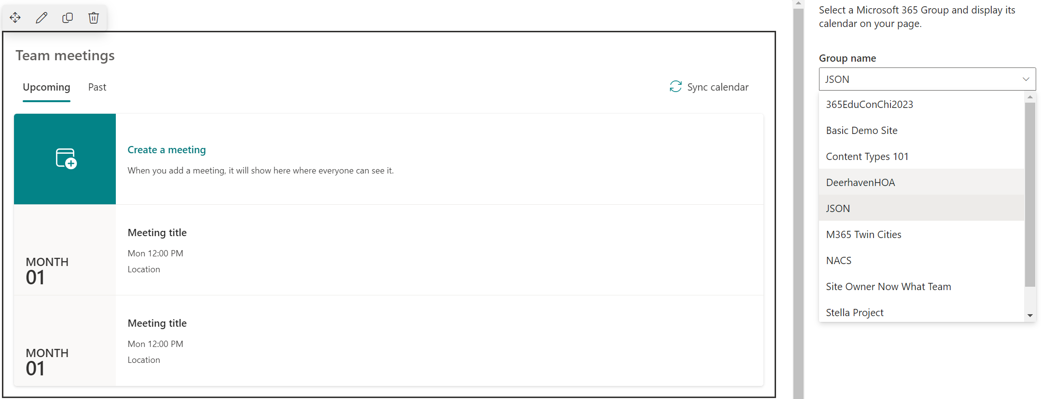
Group Calendar Web Part
Notes:
Owners & Members have access
-Can manage members through Outlook
Users can opt in to receive all invites or unfollow
Invites can be sent to Group Calendar
Calendar accessible through Outlook & SharePoint
Features:
Groups connect to other apps
Every Team has an underlying Group
Group may be hidden depending on how Team was created

Slide 9


SharePoint Calendar Options
Feature | List w/ Cal View | Classic Calendar | Events Web Part | Group Calendar
Shows in SharePoint
Shows in Teams |  | On SPO Page | On SPO Page | On SPO Page
Show in Outlook |  | Sync
Send Invites |  |  | .ics File
Recurring Events
Customizable
Created in | SharePoint | SharePoint | SharePoint | Exchange (IT)

Slide 10

Demonstration
List with Calendar View
Classic Calendar
Events Web Part
Group Web Part

Slide 11
Teams
Teams Calendar
Synced to Personal
Channel Calendar

Slide 12
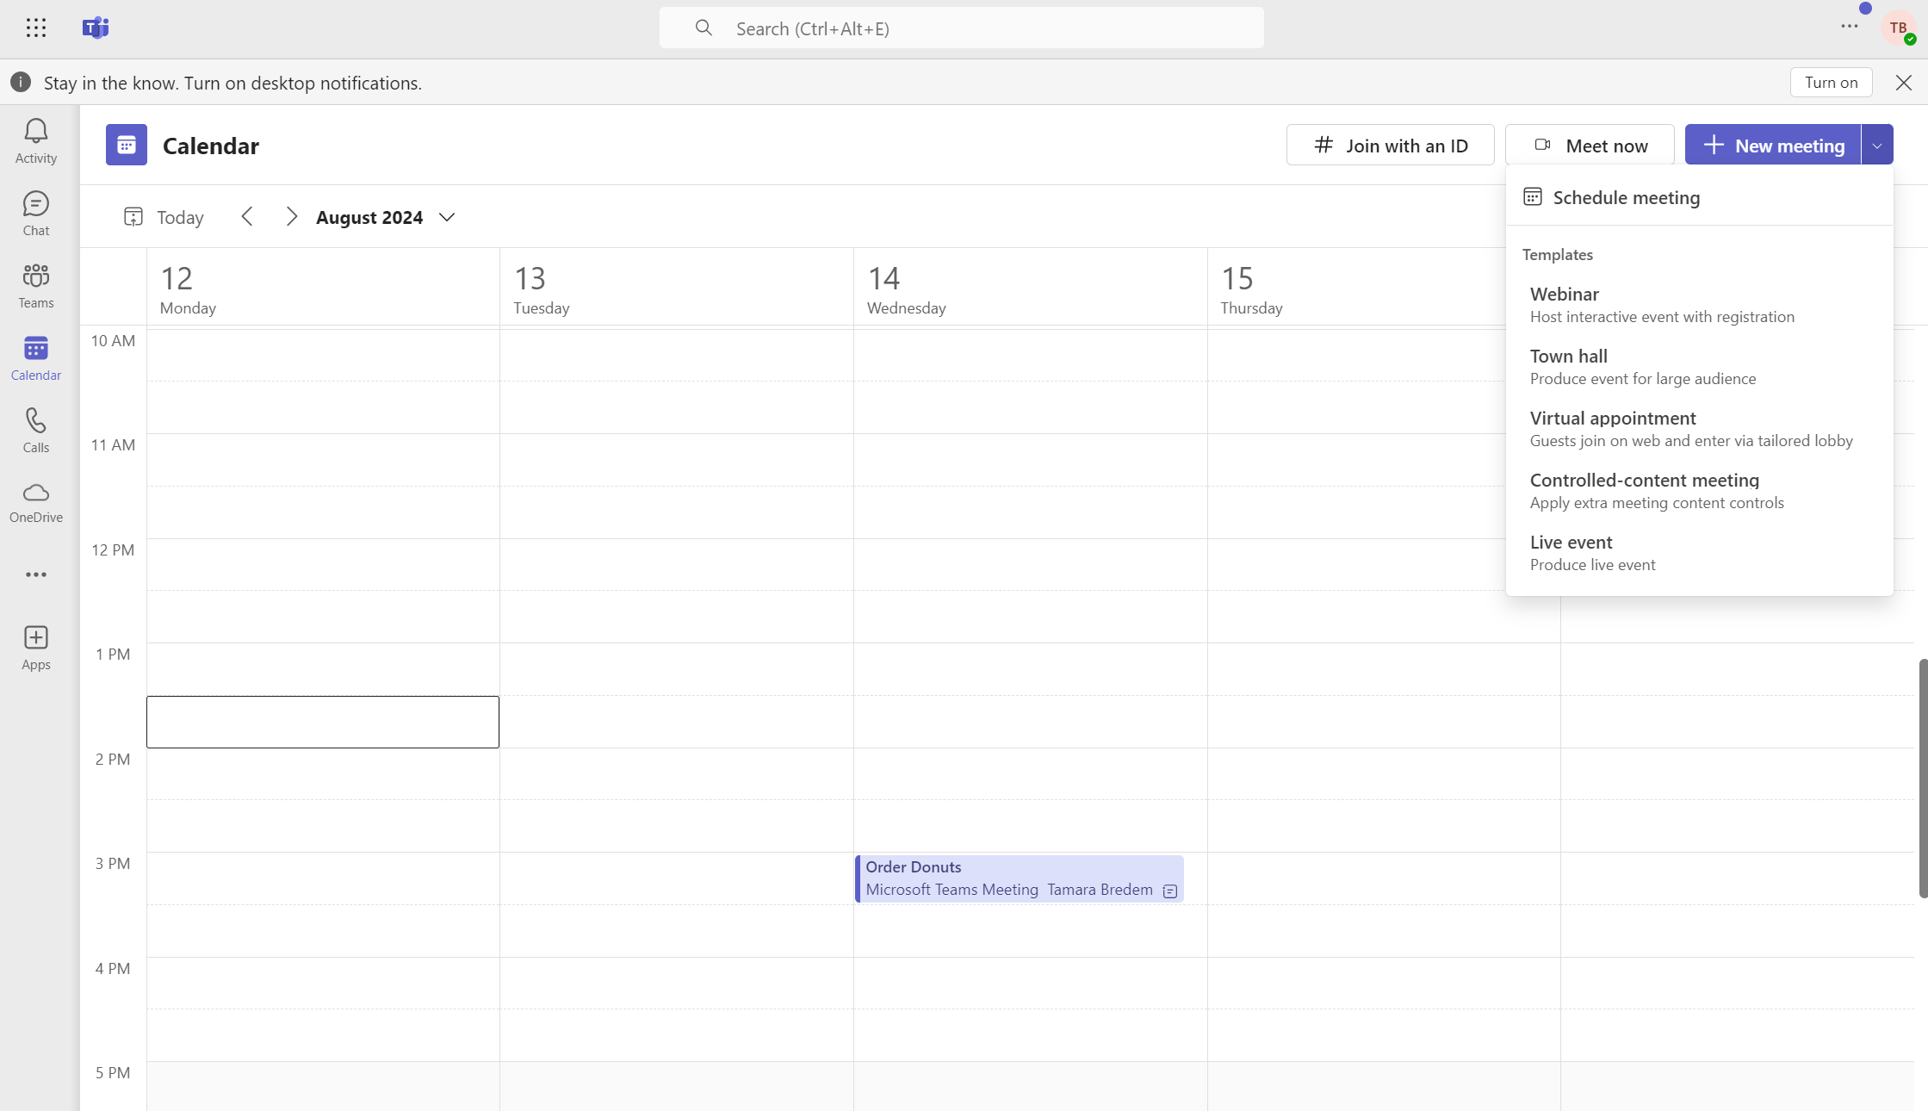
Teams Calendar
Notes:
You determine who has access
Permissions and settings managed through Outlook only
Features:
Schedule through Outlook or Teams
Sets presence status in Teams
Color Categories available in most environments
View Options are different compared to Outlook

Slide 13
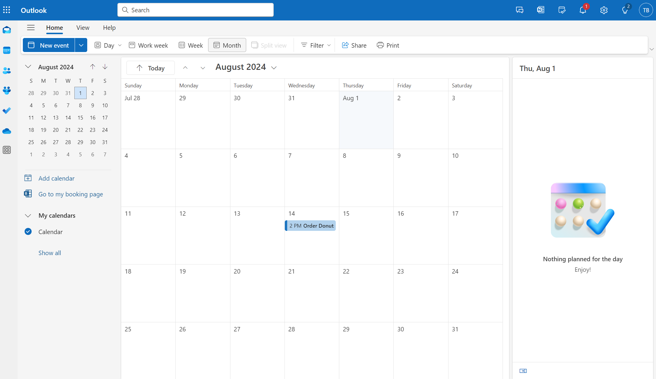
Synced to Your Outlook Personal Calendar

Slide 14
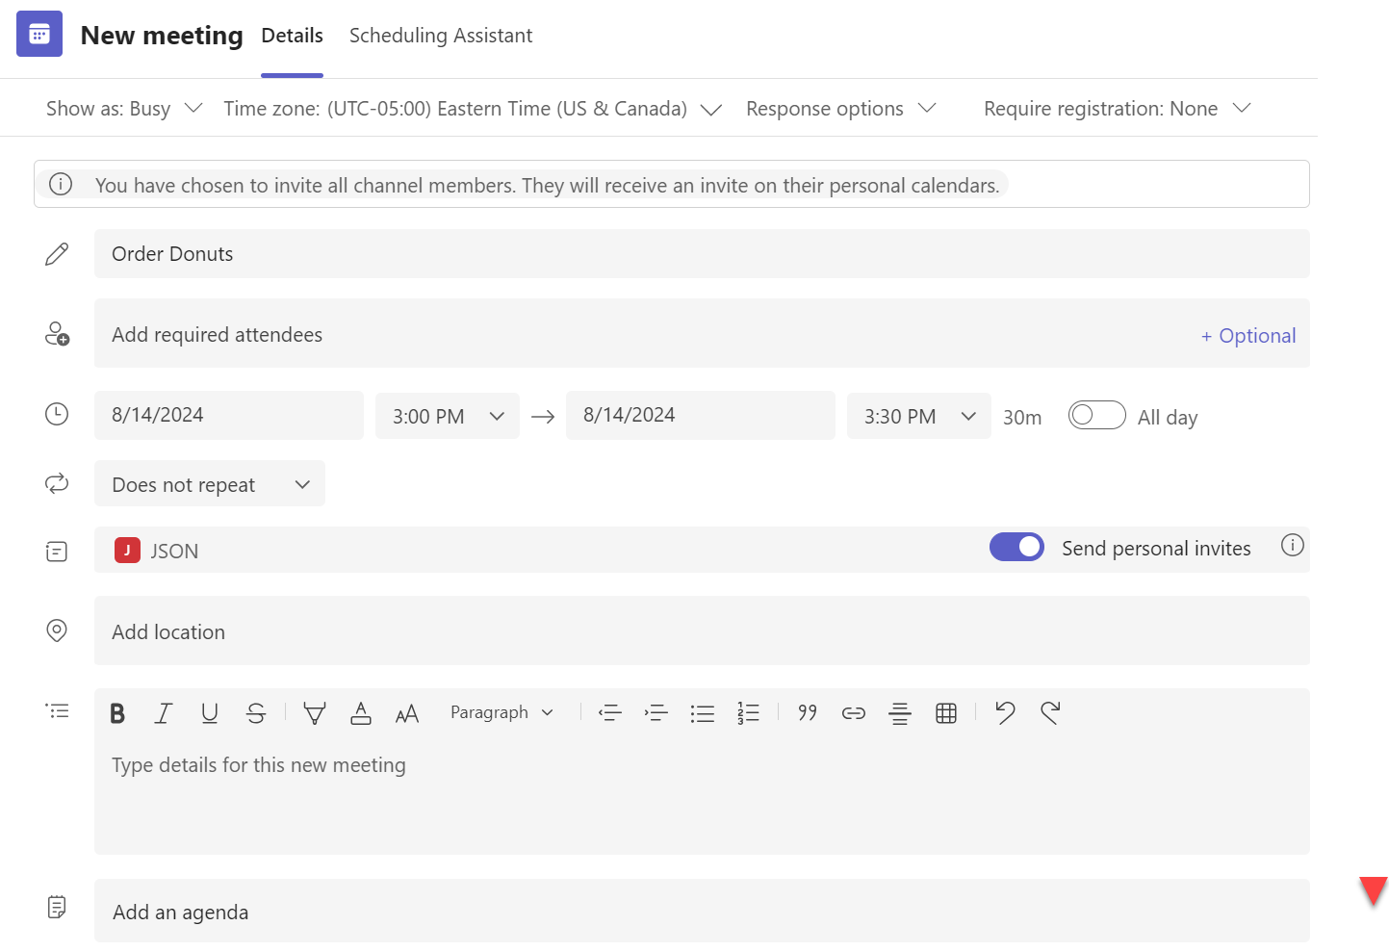
Channel Calendar

Slide 15
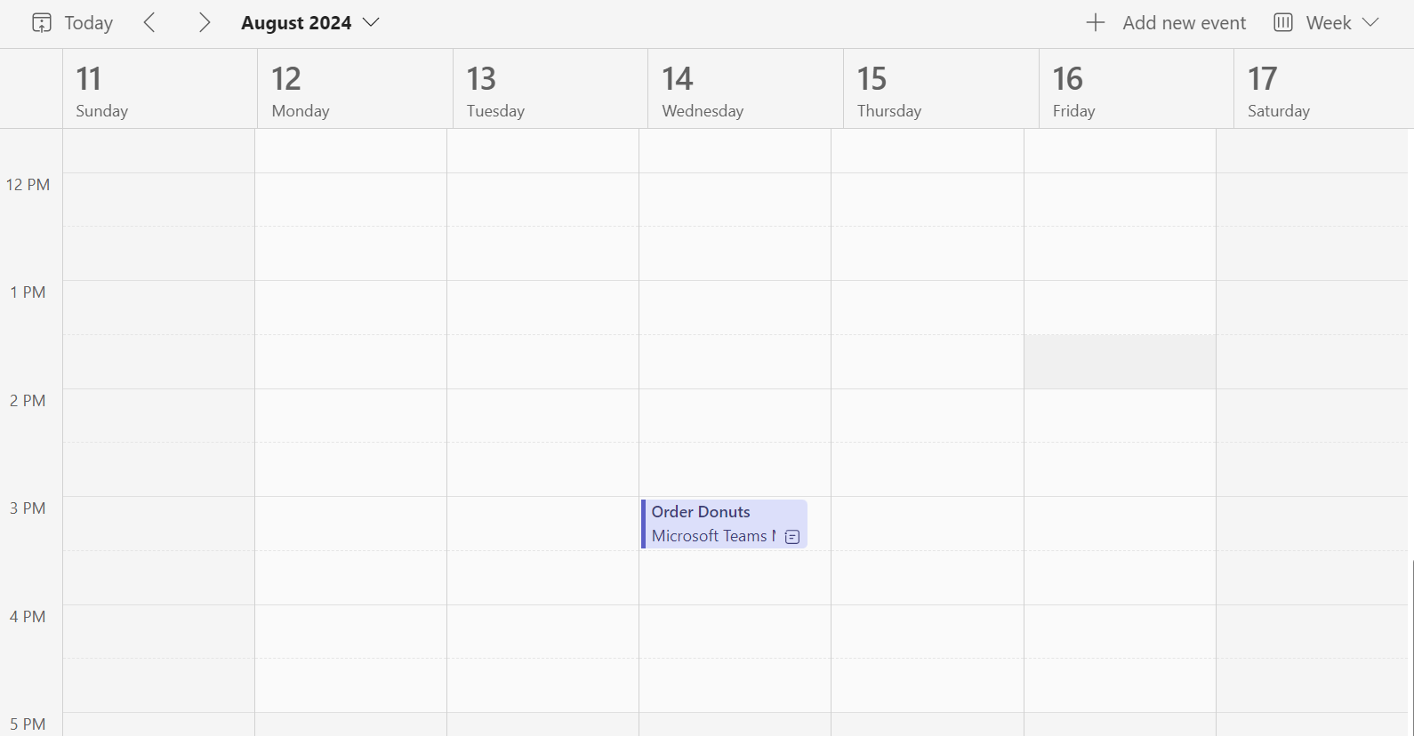
Channel Calendar
Notes:
Only available in Teams
Tied to a specific channel
Keeps chat in Posts tab
Technically is a filtered view of the underlying Group calendar
FEATURES
If you invite people outside the Team, they will not have access to chat
Cannot change or add Channels after calendar created; will need to send new invite

Slide 16
Teams Calendar Options
Feature | Teams Calendar | Channel Calendar
Shows in SharePoint
Shows in Teams
Show in Outlook
Send Invites
Recurring Events
Customizable
Created in | Teams | Teams

Slide 17
Demonstration
Channel Calendar
Synced to your Outlook
Personal Calendar

Slide 18
Outlook/Exchange
Shared Calendar
Group Calendar
Personal Calendar

Slide 19
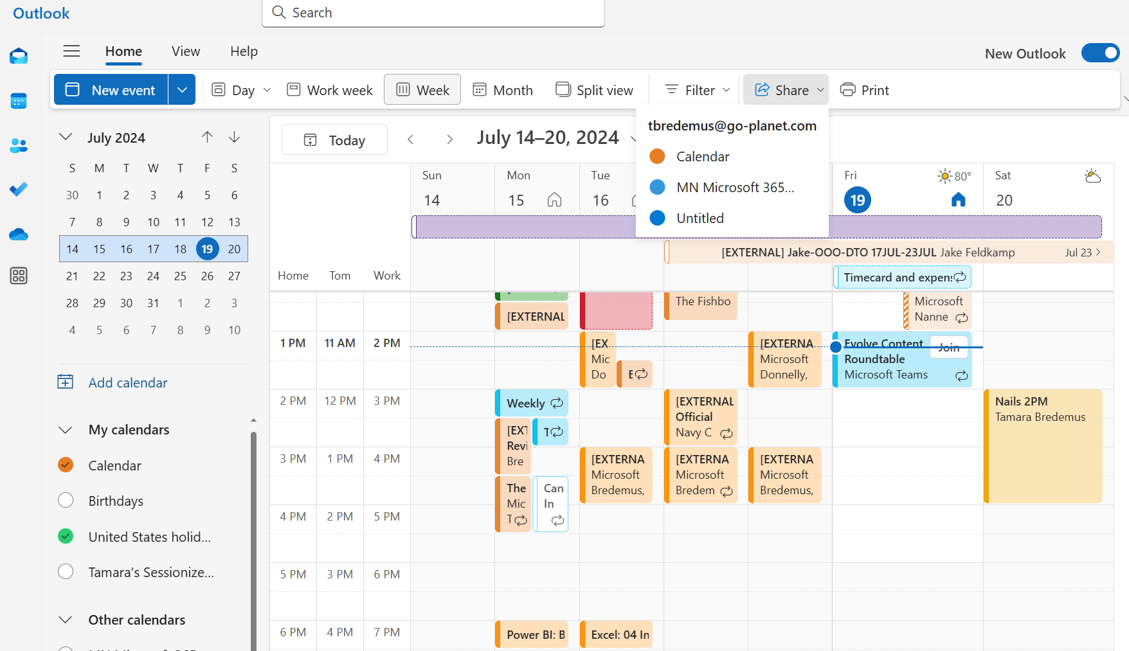

Shared Calendar

Slide 20
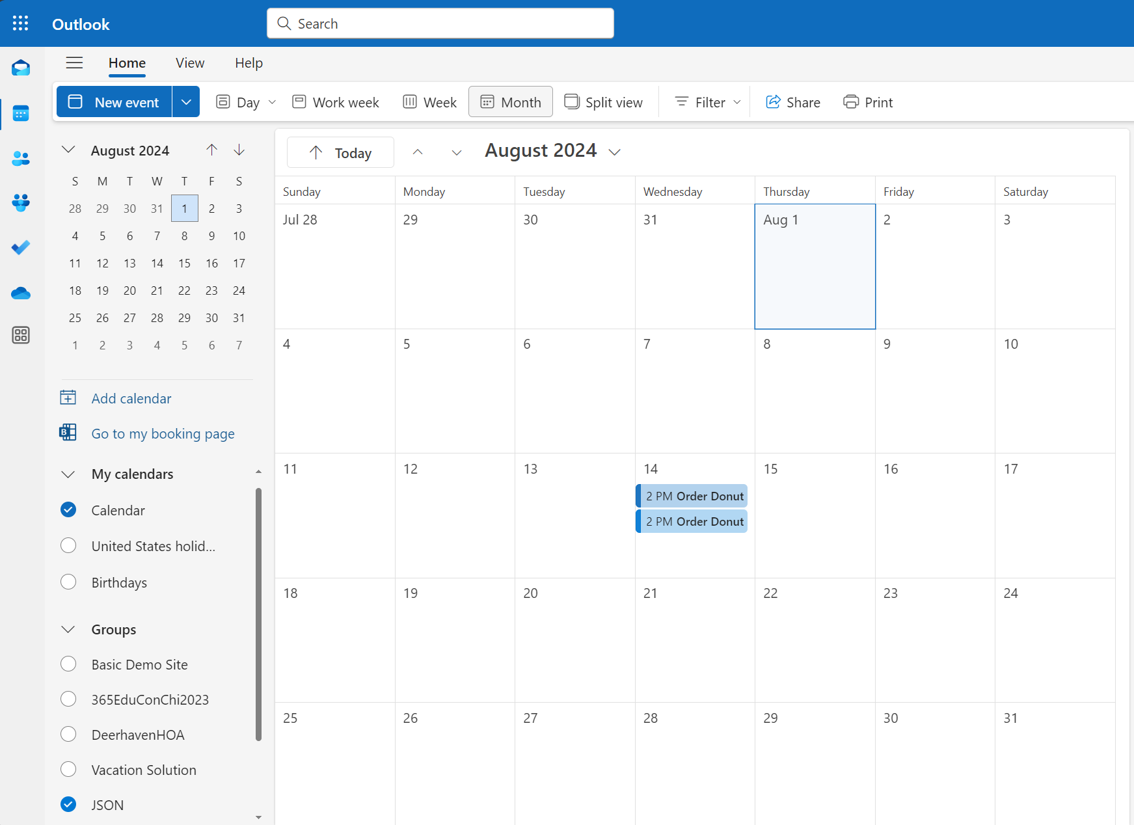
Group Calendar
Notes:
Owners & Members have access
-Can manage members through Outlook
Users can opt in to receive all invites or unfollow
Invites can be sent to Group Calendar
Calendar accessible through Outlook & SharePoint
Features:
Groups connect to other apps
Every Team has an underlying Group
Group may be hidden depending on how Team was created

Slide 21
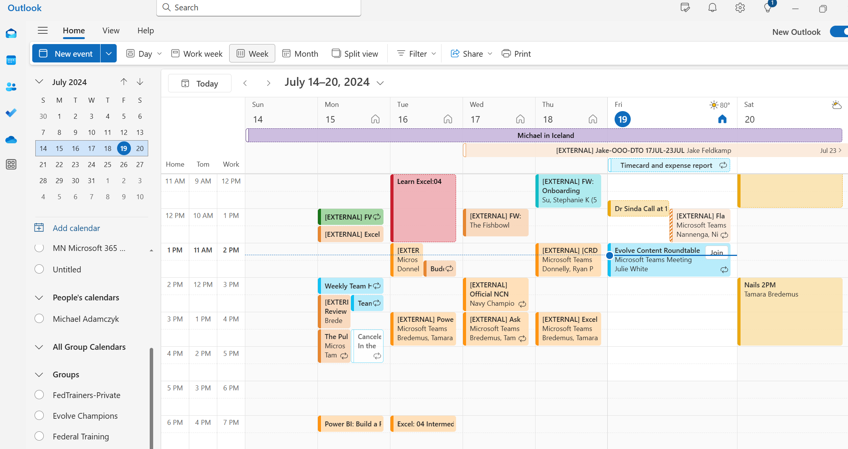
Personal Calendar
Notes:
You determine who has access to your Personal Calendar
Default Setting is Free/Busy
Can share more info with your org
Can select delegates
Can still keep “private” events
Features:
Schedule through Outlook or Teams
Sets presence status in Teams
Color categories available in most environments
Outlook Online has “My Day” view

Slide 22
Outlook Calendar Options
Feature | Shared Calendar | Group Calendar | Personal Calendar
Shows in SharePoint
Shows in Teams
Show in Outlook
Send Invites
Recurring Events
Customizable
Created in | Outlook | Outlook | Exchange

Slide 23
Demonstration
Shared Calendar
Group Calendar
Personal Calendar

Slide 24
Bookings
Personal Bookings Page

Slide 25
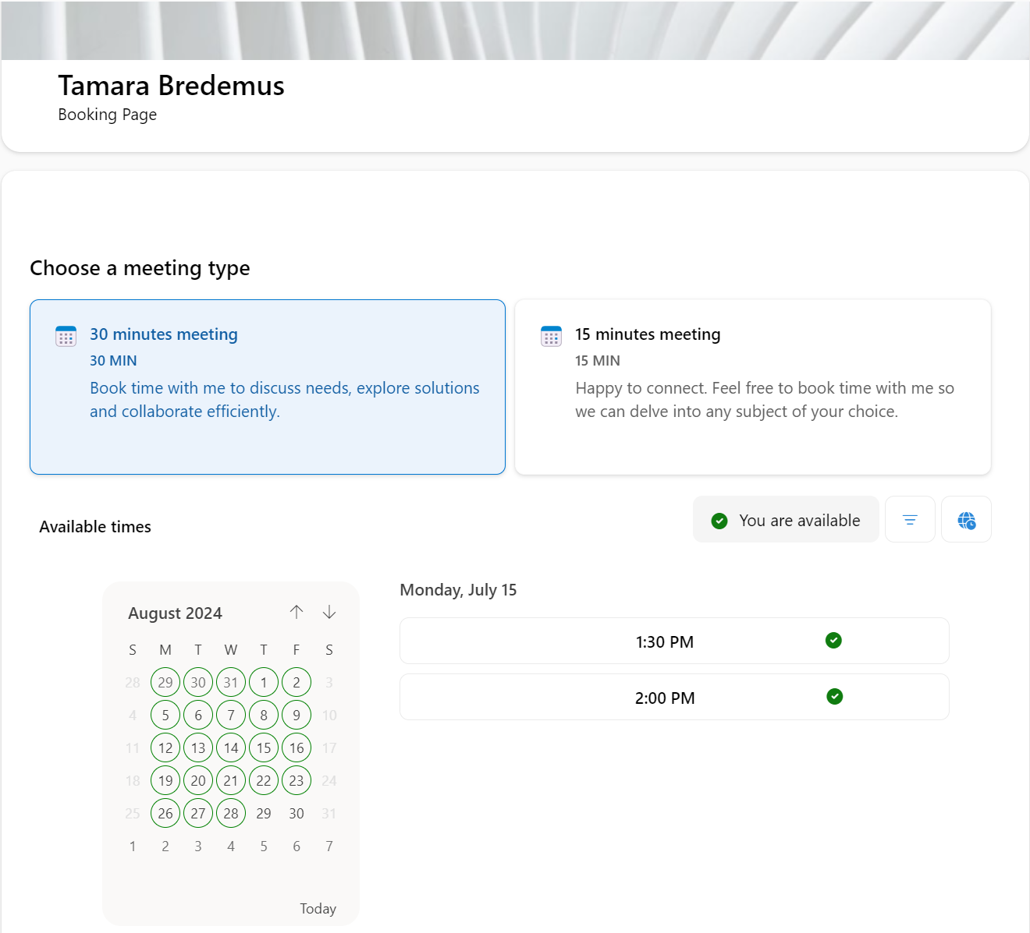
Personal Bookings Page

Slide 26
Bookings Options
Feature | Personal Bookings
Shows in SharePoint
Shows in Teams
Show in Outlook
Send Invites
Recurring Events
Customizable
Created in | Bookings

Slide 27
Demonstration
Personal Bookings Page

Slide 28
Planner
Planner Schedule

Slide 29
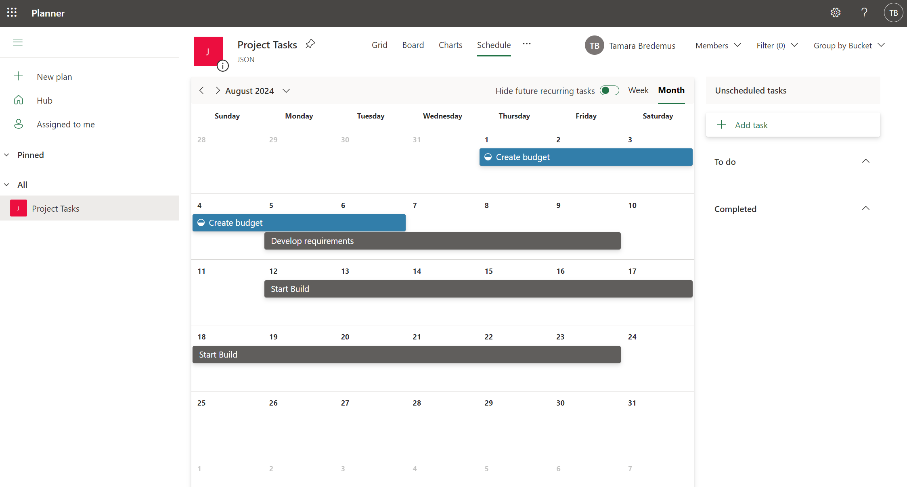
Planner Schedule

Slide 30
Planner Schedule Options
Feature | Planner Schedule
Shows in SharePoint
Shows in Teams
Show in Outlook
Send Invites
Recurring Events
Customizable
Created in | Planner

Slide 31
Demonstration
Task Calendar

Slide 32
What we learned
Not all calendars are equal
Know what you need BEFORE selecting a calendar solution
Use the matrixes to select the right calendar for you.
Keep up to date with changes with the Microsoft Roadmap

Slide 33
Calendars! Calendars! Calendars!
Investigating M365 Calendars!
Tamara.Bredemus@live.com

